Slide 1
Resources
A series on the TDF published in implementation Science
https://implementationscience.biomedcentral.com/articles/10.1186/1748-5908-7-35
A guide to using the Theoretical Domains Framework of behaviour change to investigate implementation problems
https://implementationscience.biomedcentral.com/articles/10.1186/s13012-017-0605-9
Co-designing a theory-informed intervention to increase shared decision-making in maternity care
https://pmc.ncbi.nlm.nih.gov/articles/PMC9888748/

Slide 2

Group Activity: Using the NASSS framework to conduct a context assessment to implement Digital Health Interventions

Slide 3
In 2024 almost all health interventions have:
Digital and/or e-health components
Digital health professionals are at the forefront of translational practice and transformation within health care
Implementers wear multiple hats
Active stakeholders in the process of improving health systems

Slide 4
Many intersecting determinants
Across multiple system levers

Slide 5
Key Digital Health Issues
Evidence to practice gap
Sub-optimal uptake
Abandonment over time
Inappropriate Use

Slide 6
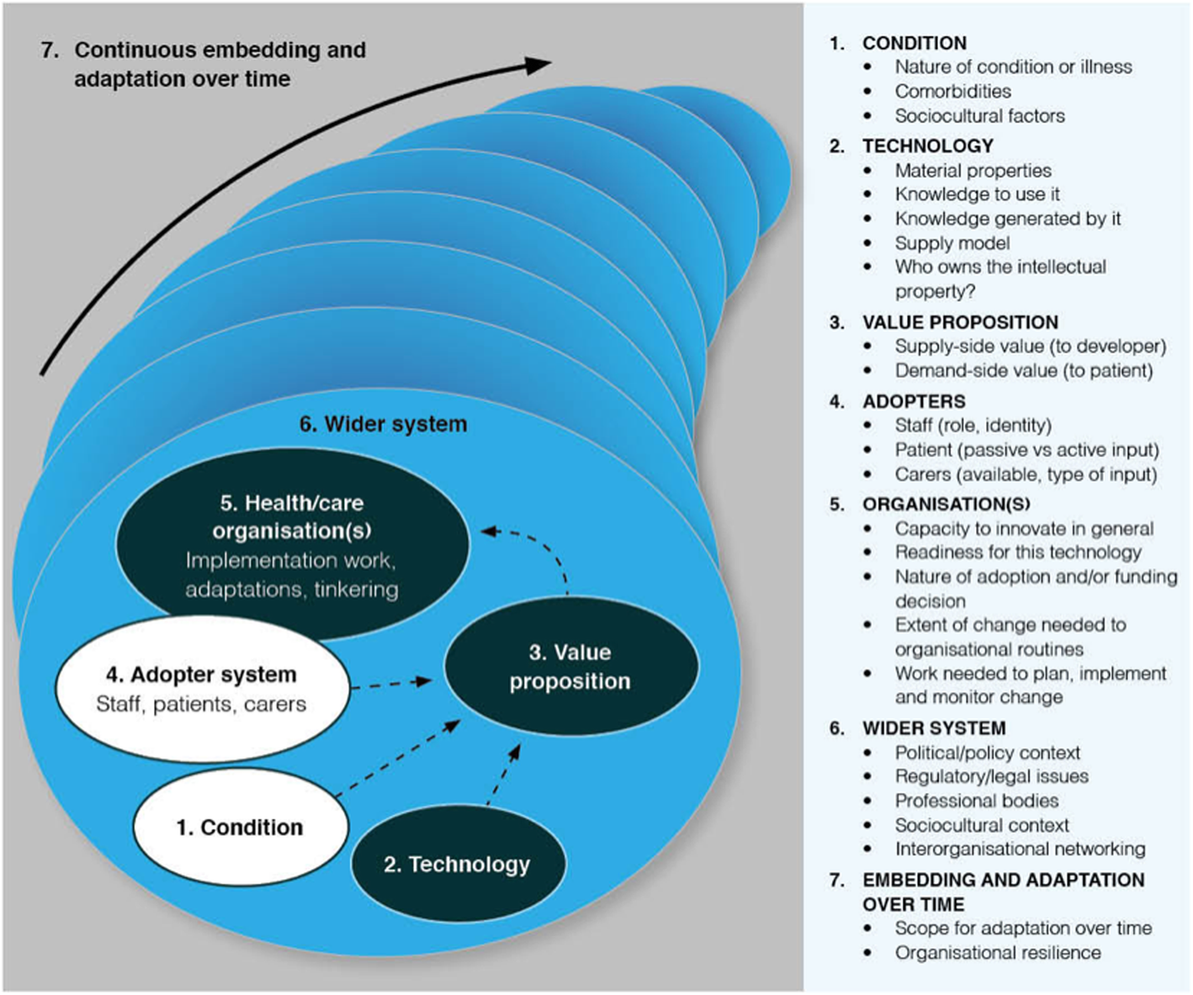
NASSS
Developed for health Technology Context
Identifies determinants related to Non-Adoption, Abandonment, Scale-Up, Spread and Sustainability for Health Care Technology
Image taken from: Greenhalgh T, Wherton J, Papoutsi C, Lynch J, Hughes G, Hinder S, Fahy N, Procter R, Shaw S. Beyond adoption: a new framework for theorizing and evaluating nonadoption, abandonment, and challenges to the scale-up, spread, and sustainability of health and care technologies. Journal of medical Internet research. 2017 Nov 1;19(11):e8775.
6

